Slide 1
Aakash Goel https://www.linkedin.com/in/goelaakash123/
Session 8:
RANSAC
Acknowledgement: Slide Materials adopted from - Intro to Computer Vision (Cornell Tech); Noah Snavely, prepared by the lead instructor Prof S P Vimal , modified (added some content) by Aakash Goel

Slide 2
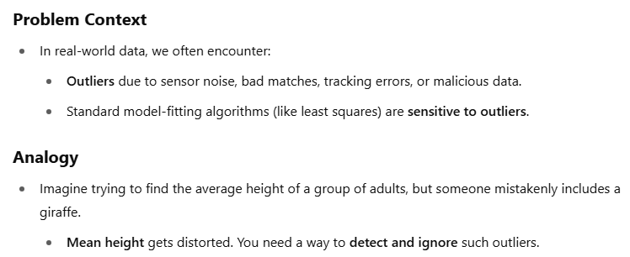
Motivation

Slide 3
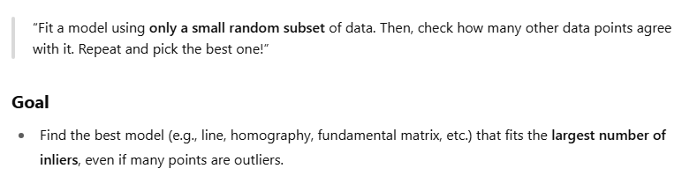
Core Idea: RANSAC

Slide 4
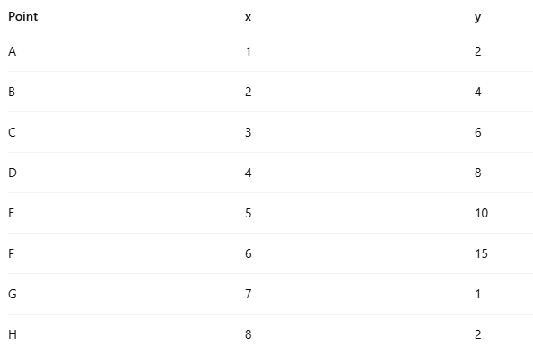
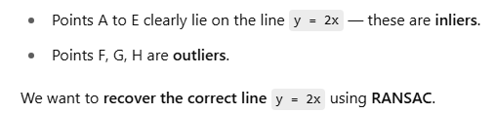
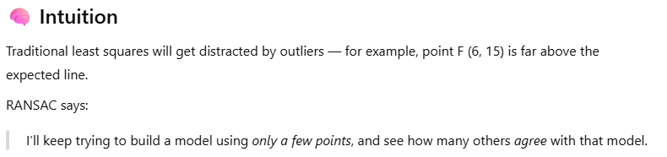
RANSAC Example

Slide 5
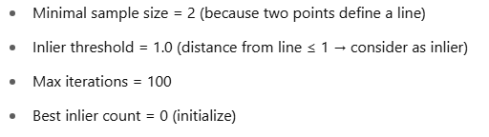
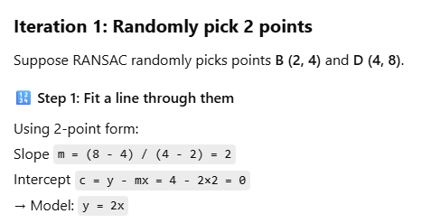
STEP 01: Choose Paramters

Slide 6
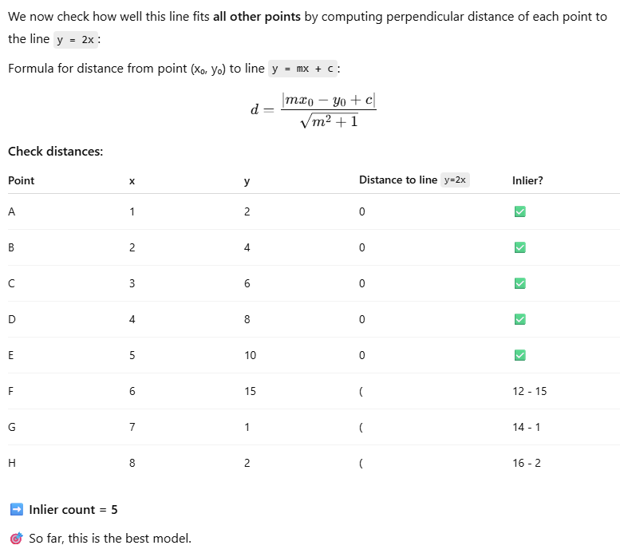
STEP 02: Count inliers

Slide 7
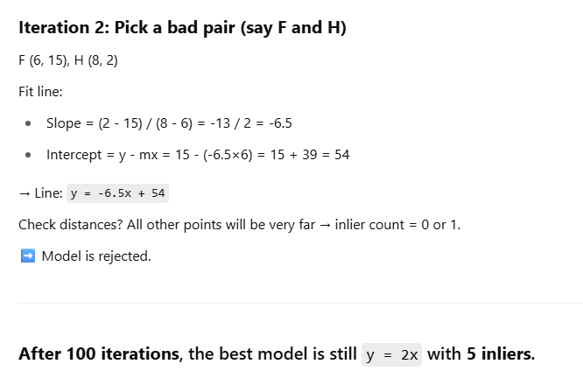
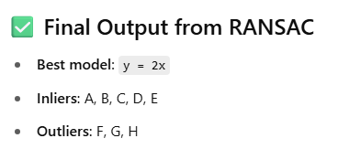


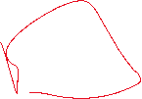










Slide 8
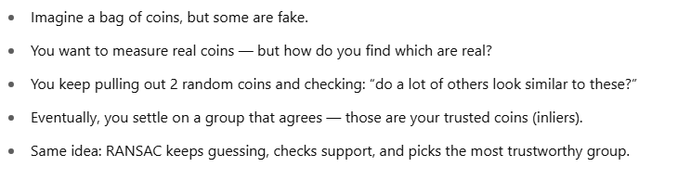
Summary

Slide 9



















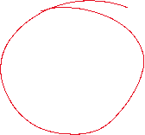

No of iterations

